Slide 1
Xamarin Android
Introduction & API levels
Kishore Kolla

Slide 2
Getting Started with Android
Xamarin.Android allows us to create native Android applications using the same UI controls we would in Java.
The flexibility and elegance of a modern language (C#), the power of the .NET Base Class Library (BCL), and two first-class IDEs - Xamarin Studio and Visual Studio - at our fingertips.

Slide 3
Setup and Installation
Windows
The Xamarin.Android installer will automatically detect, download, and install any components required for completing the installation.
Download the Installer - https://developer.xamarin.com/guides/android/getting_started/installation/windows/#download

Slide 4
Setup and Installation 2
Mac
The Xamarin.Android installer will automatically detect, download, and install any components required for completing the installation.
Download the Installer - https://developer.xamarin.com/guides/android/getting_started/installation/mac/

Slide 5
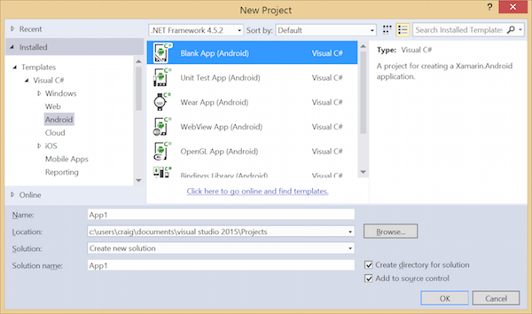
Create an Application
For example, to create a new application in Visual Studio we would choose New Project... from the Visual Studio Welcome Screen and select Android > Android Application in the New Solution dialog. Choose an application name and click OK.

Slide 6
Offline Activation
If you do not have internet access on the machine you're trying to activate, you will need to contact Xamarin Support with details of your machine. You can then obtain a license file via your Xamarin store account, provided you have purchased a license.

Slide 7
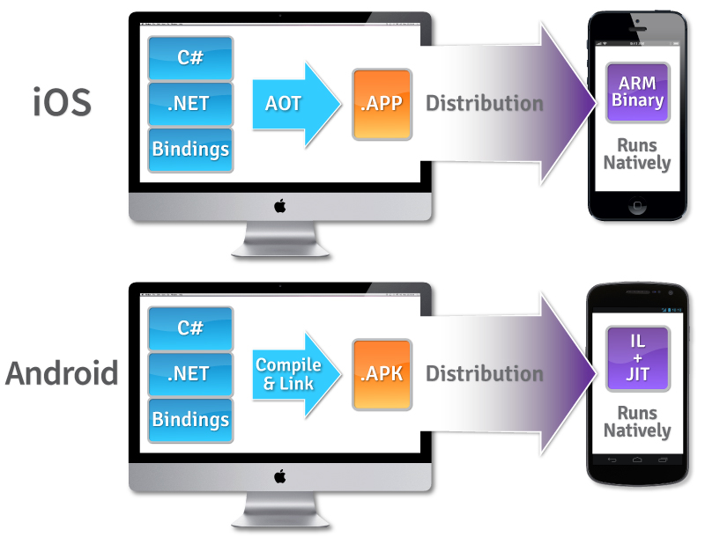
How does Mono Work?
“Xamarin compiles your app to a native binary, not cross-compiled, and not interpreted.”

Slide 8
Set Up Device for Development
Enable Debugging on the Device - By default, it will not be possible to debug applications on a Android device.
Install USB Drivers - This step is not necessary for OS X computers. Windows computers may require the installation of USB drivers.
Connect the Device to the Computer - The final step involves connecting the device to the computer by either USB or WiFi.

Slide 9
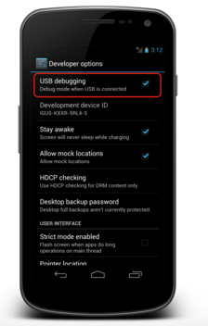
Enable Debugging on the Device
Android 4.0 to Android 4.1
Go to the Settings screen.
Select Developer options .
Check off the USB debugging option.

Slide 10
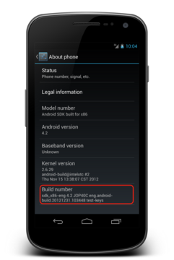
Enable Debugging on the Device 2
Android 4.2 and higher
Starting in Android 4.2 and higher, the Developer options is hidden by default. To make it available, go to Settings > About phone, and tap the Build number item seven times to reveal the Developer Options tab.
Once the Developer Options tab is available under Settings > System, open it to reveal developer settings

Slide 11
Install USB Drivers
It may be necessary to install some extra drivers before a Windows computer will recognize an Android device connected by USB.
Install the Google USB Driver package by starting the Android SDK Manager, and expanding the Extras folder.

Slide 12
Connect the Device to the Computer
USB cable - This is the easiest and most common way. Just plug the USB cable into the device and then into the computer.
WiFi - It is possible to connect an Android device to a computer without using a USB cable, over WiFi. This technique requires a bit more effort but could be useful when there is no USB cable or the device is to far away for a USB cable
Follow the link for more https://developer.xamarin.com/guides/android/getting_started/installation/set_up_device_for_development/

Slide 13
Xamarin Android Player
A high performance Android simulator from Xamarin.
The Xamarin Android Player utilizes VT-x and AMD-V hardware accelerated virtualization and OpenGL 2.0 to provide fast boot times and a snappy, smooth user interface. It allows fine-grained control over hardware features such as the battery level or the device location.
For more https://developer.xamarin.com/guides/android/getting_started/installation/android-player/

Slide 14
Hello, Android
In this walkthrough, we create an application that translates an alphanumeric phone number entered by the user into a numeric phone number, and then calls that number

Slide 15
Understanding Android API Levels
Xamarin.Android has several Android API level settings that determine your app's compatibility with multiple versions of Android.
Target Framework – Specifies which framework to use in building your application. This API level is used at compiletime by Xamarin.Android.
Minimum Android Version – Specifies the oldest Android version that you want your app to support. This API level is used at run time by Android.
Target Android Version – Specifies the version of Android that your app is intended to run on. This API level is used at run time by Android.

Slide 16
Android Versions
Android Version | Released | API Level | Name
Android 6.0 | Aug-15 | 23 | Marshmallow
Android 5.1 | Mar-15 | 22 | Lollipop
Android 5.0 | Nov-14 | 21 | Lollipop
Android 4.4W | Jun-14 | 20 | Kitkat Watch
Android 4.4 | Oct-13 | 19 | Kitkat
Android 4.3 | Jul-13 | 18 | Jelly Bean
Android 4.2-4.2.2 | Nov-12 | 17 | Jelly Bean
Android 4.1-4.1.1 | Jun-12 | 16 | Jelly Bean
Android 4.0.3-4.0.4 | Dec-11 | 15 | Ice Cream Sandwich
Android 4.0-4.0.2 | Oct-11 | 14 | Ice Cream Sandwich
Android 3.2 | Jun-11 | 13 | Honeycomb
Android 3.1.x | May-11 | 12 | Honeycomb
Android 3.0.x | Feb-11 | 11 | Honeycomb
Android 2.3.3-2.3.4 | Feb-11 | 10 | Gingerbread
Android 2.3-2.3.2 | Nov-10 | 9 | Gingerbread
Android 2.2.x | Jun-10 | 8 | Froyo
Android 2.1.x | Jan-10 | 7 | Eclair
Android 2.0.1 | Dec-09 | 6 | Eclair
Android 2.0 | Nov-09 | 5 | Eclair
Android 1.6 | Sep-09 | 4 | Donut
Android 1.5 | May-09 | 3 | Cupcake
Android 1.1 | Feb-09 | 2 | Base
Android 1.0 | Oct-08 | 1 | Base

Slide 17
Queries?

